Slide 1
Describing End Behavior and Turns
Describing End Behavior and Turns

Slide 2
Warm-Up
Describing End Behavior and Turns

Slide 3
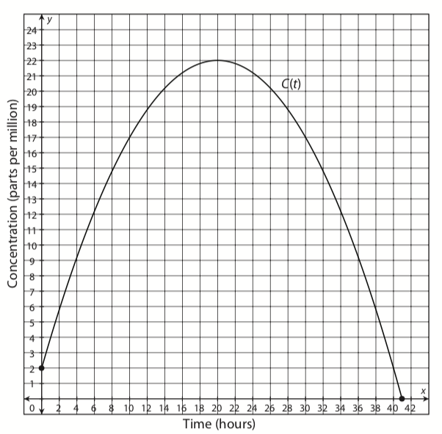
The graphed function at right represents the concentration, in parts per million, of a particular medication in the bloodstream after t hours.
Use the graph to answer the questions that follow.
Describing End Behavior and Turns

Slide 4
When is the concentration increasing? Decreasing?
After how many hours is the concentration of medicine at its highest? What is the concentration at this time?
What is the x-intercept and what does it represent?
What is the y-intercept and what does it represent?
Describing End Behavior and Turns

Slide 5
When is the concentration increasing? Decreasing?
  The function starts
  increasing when the
  amount of time passed
  is at 0, and continues
  increasing until the
  function reaches the
  vertex, (20, 22).
  From that point, the
  function is decreasing.
(20,22)
Describing End Behavior and Turns

Slide 6
  This means that the concentration of medication is increasing when the amount of time passed is less than 20 hours, or t < 20.
(20,22)
Describing End Behavior and Turns

Slide 7
  The concentration is decreasing when the amount of time passed is greater than 20 hours, or t > 20.
(20,22)
Describing End Behavior and Turns

Slide 8
After how many hours is the concentration of medicine at its highest? What is the concentration at this time?
  Use the vertex of the
  function to determine
  the maximum
  concentration.
Vertex
Describing End Behavior and Turns

Slide 9
  The vertex of this function is (20, 22); therefore, 20 hours after a person takes the medication, the medication is at its highest concentration of 22 parts per million.
(20,22)
Describing End Behavior and Turns

Slide 10
What is the x-intercept and what does it represent?
  The x-intercept is
  the point at which
  the function crosses
  the x-axis.
x-intercept
Describing End Behavior and Turns

Slide 11
In this graph, the x-intercept appears to be (41, 0) and represents when, 41 hours after the dose is first taken, the concentration of medicine in the bloodstream is 0 parts per million.
(41,0)
Describing End Behavior and Turns

Slide 12
What is the y-intercept and what does it represent?
The y-intercept is the
point at which the
function crosses the
y-axis.
y-intercept
Describing End Behavior and Turns
Notes:
Connection to the Lesson
Students will extend their understanding of when functions are increasing and decreasing.
Students will also extend their understanding of maximums and minimums of quadratic functions to that of identifying local maximums and minimums of polynomial functions.
Students will interpret maximums and minimums as well as x- and y-intercepts of polynomial functions.

Slide 13
In this graph, the y-intercept appears to be (0, 2).
It represents the time when the dose is first taken, at t = 0, and the concentration in the bloodstream at that time, 2 parts per million.
(0,2)
Describing End Behavior and Turns
Notes:
Connection to the Lesson
Students will extend their understanding of when functions are increasing and decreasing.
Students will also extend their understanding of maximums and minimums of quadratic functions to that of identifying local maximums and minimums of polynomial functions.
Students will interpret maximums and minimums as well as x- and y-intercepts of polynomial functions.

Slide 14
Instruction

Slide 15
Introduction
By this point in your mathematics experience, you have worked extensively with functions:
determining the slopes of linear functions,
identifying the vertices of quadratic functions as maxima or minima,
determining the end behavior of exponential functions,
and identifying intercepts of many types of functions.

Slide 16
Introduction, continued
You can extend the skills you have used to analyze functions you have previously studied in order to understand the graphs of other polynomial functions.

Slide 17
Key Concepts
Recall that a polynomial function is a function with a general form of
where a₁ is a rational number, a_{n} ≠ 0, and n is the highest degree of the polynomial.
Polynomial functions are defined for any function that contains positive integer exponents.
Recall that integers are numbers that are not fractions or decimals.
$$f\left(x\right)=a_{n}x^{n}+a_{n−1}x^{n−1}+…+a_{1}x^{1}+a_{0}$$

Slide 18
Key Concepts, continued
The degree of a polynomial function is the highest exponent to which the dependent variable is raised.
For example, the equation y = 3x⁷ + 9x³ – x + 4 is a seventh-degree polynomial function because its highest exponent is 7 and all other exponents are positive whole numbers.

Slide 19
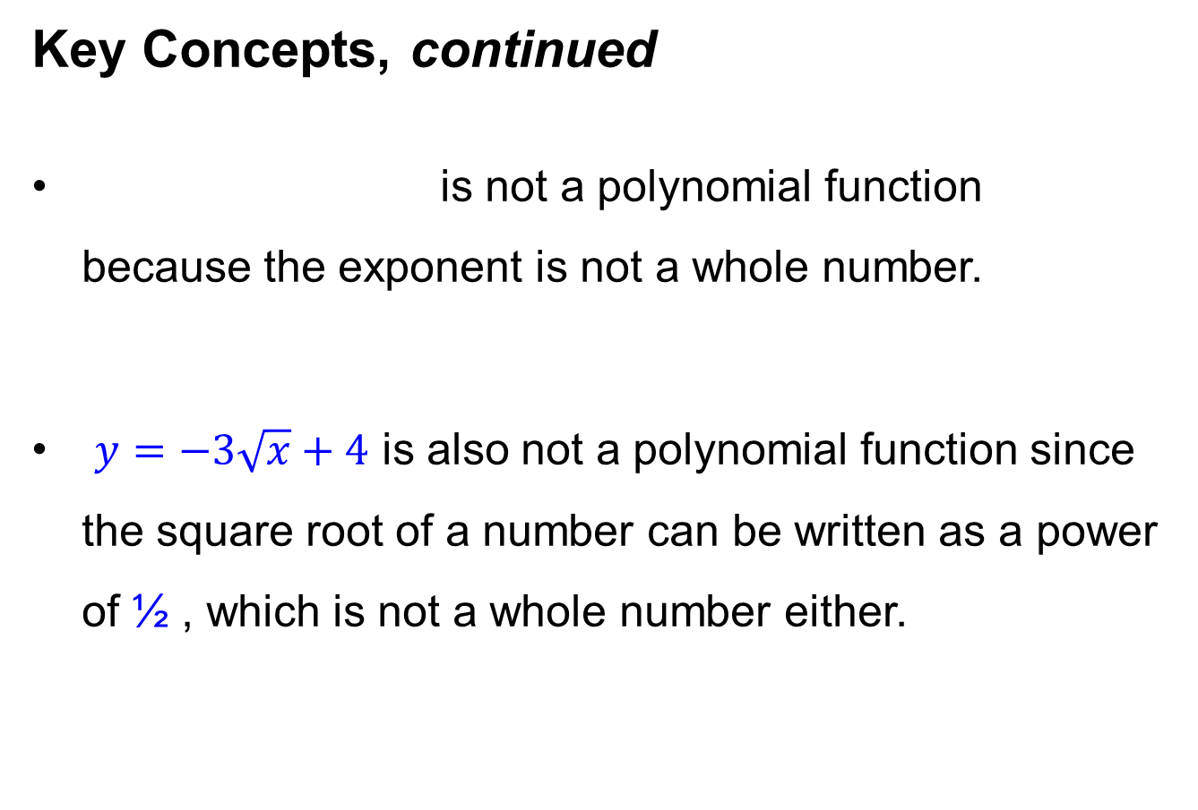

Key Concepts, continued
is not a polynomial function because the exponent is not a whole number.
$y=−3\sqrt{x}+4$ is also not a polynomial function since the square root of a number can be written as a power of ½ , which is not a whole number either.
$$y=4x^{\frac{3}{5}}+6x−3$$

Slide 20

Key Concepts, continued
And $y=5x^{3}+2x^{−4}+6$ is not a polynomial function because not all exponents are non-negative integers.

Slide 21
Key Concepts, continued
End Behavior
To determine the end behavior of a polynomial function, or the behavior of the graph as x approaches positive or negative infinity, consider the highest degree of the polynomial and its coefficient, ax^{n}.
If n is even, the polynomial function is considered an even-degree polynomial function.

Slide 22
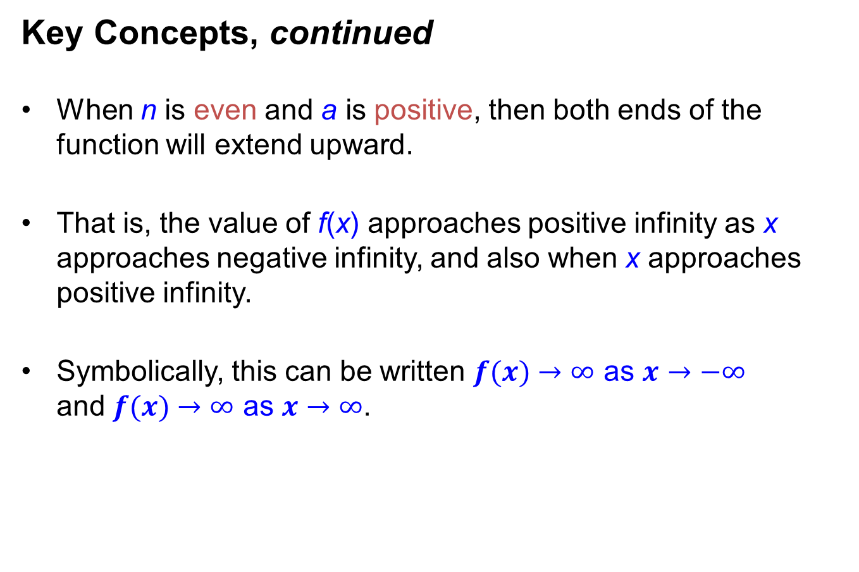
Key Concepts, continued
When n is even and a is positive, then both ends of the function will extend upward.
That is, the value of f(x) approaches positive infinity as x approaches negative infinity, and also when x approaches positive infinity.
Symbolically, this can be written $f(x)→∞$ as $x→−∞$ and $f(x)→∞$ as $x→∞$.

Slide 23
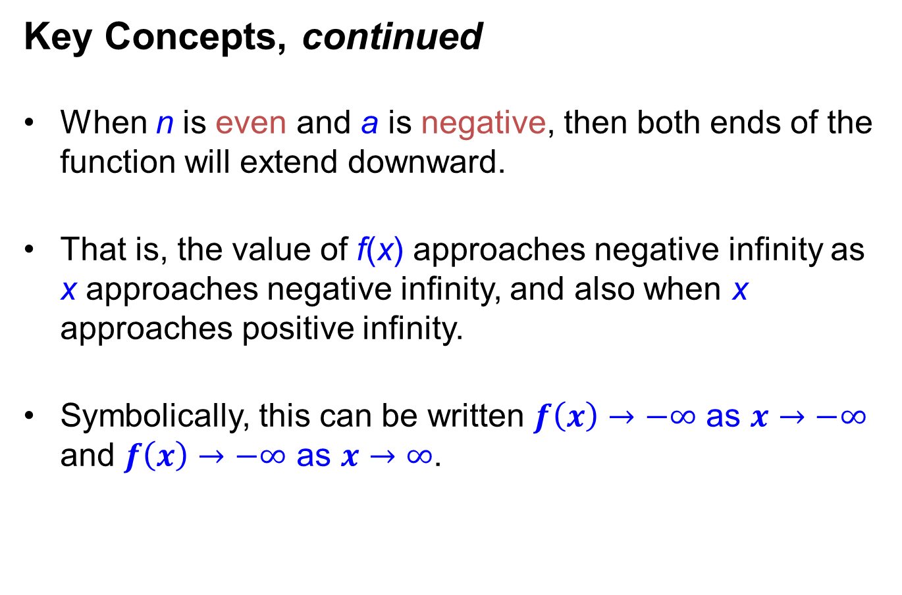
Key Concepts, continued
When n is even and a is negative, then both ends of the function will extend downward.
That is, the value of f(x) approaches negative infinity as x approaches negative infinity, and also when x approaches positive infinity.
Symbolically, this can be written $f\left(x\right)→−∞$ as $x→−∞$
and $f\left(x\right)→−∞$ as $x→∞$.

Slide 24
Key Concepts, continued
If n is odd, the polynomial function is considered an odd-degree polynomial function.
When n is odd and a is positive, then one end of the function will extend down to the left and the other end will extend up to the right.

Slide 25
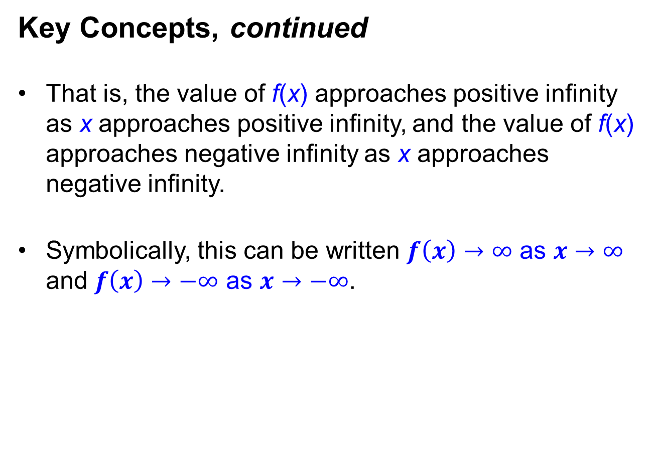
Key Concepts, continued
That is, the value of f(x) approaches positive infinity as x approaches positive infinity, and the value of f(x) approaches negative infinity as x approaches negative infinity.
Symbolically, this can be written $f\left(x\right)→∞$ as $x→∞$ and $f\left(x\right)→−∞$ as $x→−∞$.

Slide 26
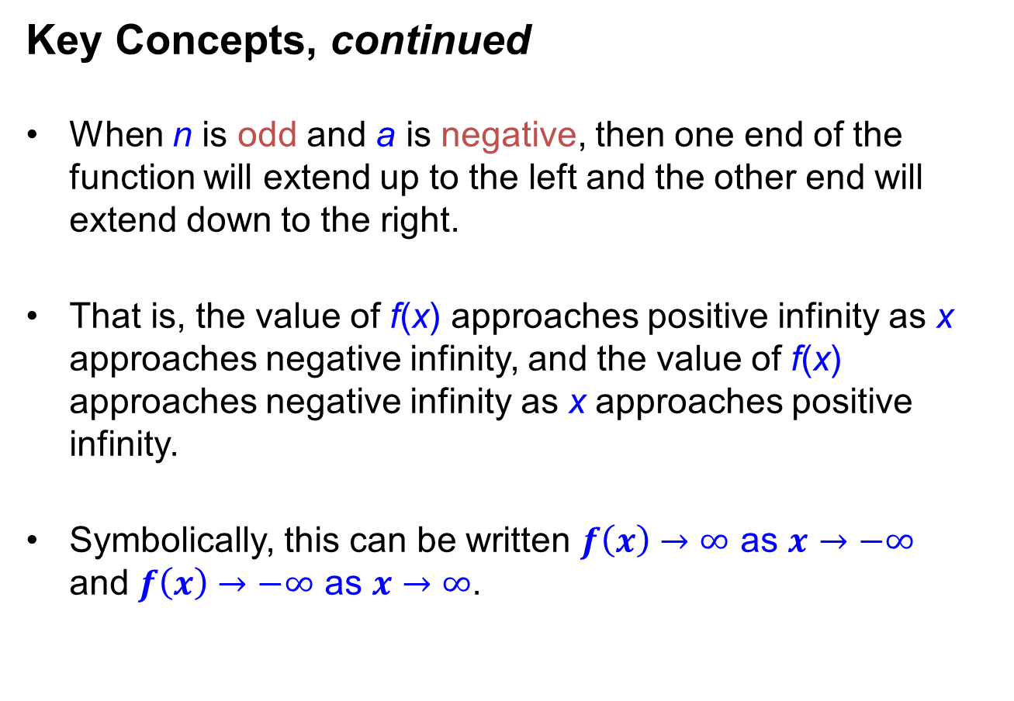
Key Concepts, continued
When n is odd and a is negative, then one end of the function will extend up to the left and the other end will extend down to the right.
That is, the value of f(x) approaches positive infinity as x approaches negative infinity, and the value of f(x) approaches negative infinity as x approaches positive infinity.
Symbolically, this can be written $f\left(x\right)→∞$ as $x→−∞$ and $f\left(x\right)→−∞$ as $x→∞$.

Slide 27
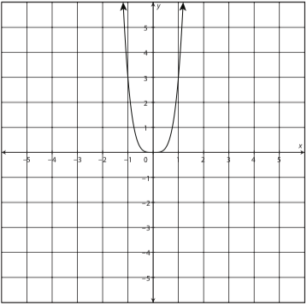
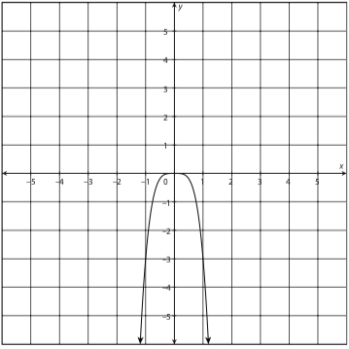




Key Concepts, continued
Even-degree polynomials
Positive leading coefficient Example: y = 3x⁴ | Negative leading coefficient Example: y = –3x⁴
$f\left(x\right)→∞$ as $x→−∞$
$f\left(x\right)→−∞$ as $x→−∞$
$f\left(x\right)→∞$ as $x→∞$
$f\left(x\right)→−∞$ as $x→∞$

Slide 28
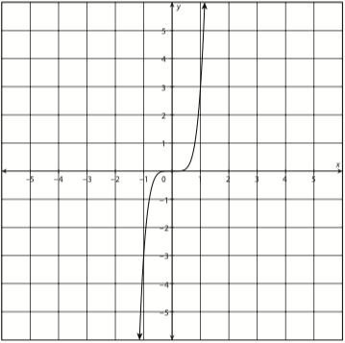
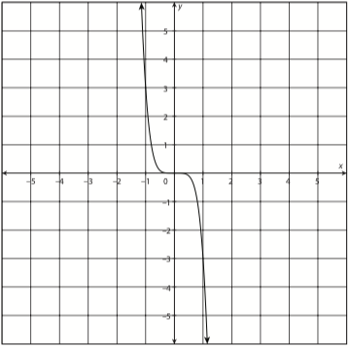




Key Concepts, continued
Odd-degree polynomials
Positive leading coefficient Example: y = 3x⁵ | Negative leading coefficient Example: y = –3x⁵
Key Concepts, continued
$f\left(x\right)→−∞$ as $x→−∞$
$f\left(x\right)→∞$ as $x→−∞$
$f\left(x\right)→∞$ as $x→∞$
$f\left(x\right)→−∞$ as $x→∞$

Slide 29
Key Concepts, continued
Turning Points
A turning point of a function is a point where the graph of the function changes from sloping upward to sloping downward or, alternatively, from sloping downward to sloping upward.
To determine the maximum number of turning points of a function, subtract 1 from the highest degree of the polynomial. In other words, find n – 1.

Slide 30
Key Concepts, continued
For instance, the polynomial function y = 3x⁷ + 9x³ – x + 4 can have no more than 7 – 1, or 6, turning points.
The maximum number of turning points does not necessarily indicate the actual number of turning points of a function, just that it can have no more than that number.
Some functions may have fewer turning points than the number calculated.

Slide 31
Key Concepts, continued
A turning point corresponds to a local maximum, the greatest value of a function for a particular interval of the function, or a local minimum, the least value of a function for a particular interval of the function.
A local maximum may also be referred to as a relative maximum and a local minimum may also be referred to as a relative minimum.

Slide 32
Key Concepts, continued
Roots of a Polynomial Function
The highest degree of the polynomial determines the maximum number of roots, or x-intercepts of a function.
A polynomial function with a degree of 10 could have up to 10 roots, but could also have 0 to 9 roots, depending on the specific equation.

Slide 33
Key Concepts, continued
Recall that real numbers include all rational and irrational numbers, but do not include imaginary and complex numbers.

Slide 34
Key Concepts, continued
Sketching a Polynomial Function
Being able to identify the general end behavior, the possible number of turning points, and the maximum number of roots of a polynomial function can be helpful in creating a rough sketch of the function.
Start by choosing at least six x-values that are both positive and negative. It is also useful to choose the value of 0.

Slide 35
Key Concepts, continued
As you’ve done in previous courses, substitute each chosen x-value into the given function and evaluate to determine the corresponding y-value. Then, plot the points on a graph.
Be sure to smoothly connect all chosen points to illustrate the graph of the function.
Graphing calculators are especially helpful when sketching a complicated function.

Slide 36
Common Errors/Misconceptions
assuming the maximum number of calculated turning points is the actual number of turning points of a function
assuming the maximum number of roots is the actual number of roots of a function
not using the highest degree term to identify the end behavior of the polynomial function

Slide 37
Common Errors/Misconceptions, cont.
not using the highest degree of the polynomial function to determine the maximum number of turns
confusing even-degree and odd-degree functions with even and odd functions

Slide 38
Guided Practice
Example 1
Determine the end behavior, maximum number of turning points, and maximum number of real roots of the function f(x) = 6x⁵ – 3x⁴ + 2x + 7.

Slide 39
Guided Practice: Example 1, continued
Identify the leading coefficient and degree of the polynomial function.
  The function f(x) = 6x⁵ – 3x⁴ + 2x + 7 is a fifth-degree polynomial function because the highest exponent is 5.
  The coefficient of the term containing the highest exponent is 6; therefore, 6 is the leading coefficient.

Slide 40
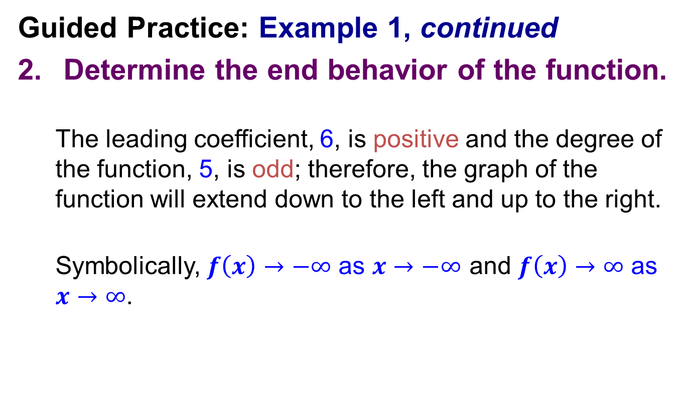
Guided Practice: Example 1, continued
Determine the end behavior of the function.
  The leading coefficient, 6, is positive and the degree of the function, 5, is odd; therefore, the graph of the function will extend down to the left and up to the right.
  Symbolically, $f\left(x\right)→−∞$ as $x→−∞$ and $f\left(x\right)→∞$ as $x→∞$.

Slide 41
Guided Practice: Example 1, continued
Determine the maximum number of turning points of the polynomial function.
  To determine the maximum number of turning points, subtract 1 from the degree of the polynomial; that is, find n – 1.
  The degree of the polynomial is 5, and 5 – 1 = 4.
  The maximum number of turning points in the graph
  is 4.

Slide 42
Guided Practice: Example 1, continued
Determine the maximum number of real roots of the polynomial function.
The maximum number of real roots is equal to the degree of the polynomial; therefore, the maximum number of roots of the function f(x) = 6x⁵ – 3x⁴ + 2x + 7 is 5.
✔

Slide 43

Guided Practice: Example 1, continued
Notes:
http://www.walch.com/ei/00521

Slide 44
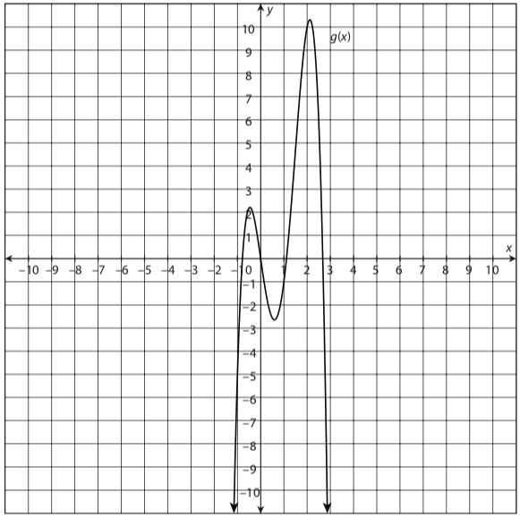
Guided Practice
Example 2
Describe the end behavior of the given graph of g(x).
Determine whether the graph represents an even-degree or odd-degree function, and determine the number of real roots.

Slide 45
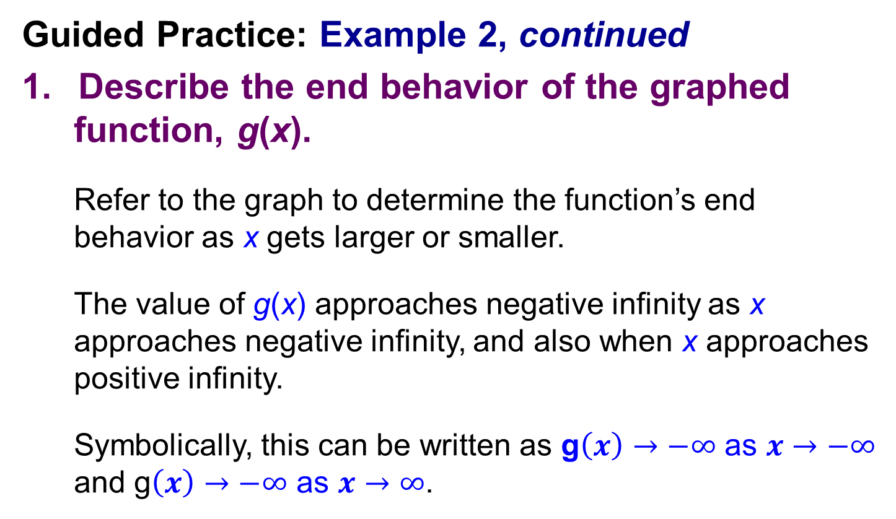
Guided Practice: Example 2, continued
Describe the end behavior of the graphed function, g(x).
Refer to the graph to determine the function’s end behavior as x gets larger or smaller.
The value of g(x) approaches negative infinity as x approaches negative infinity, and also when x approaches positive infinity.
Symbolically, this can be written as g$\left(x\right)→−∞$ as $x→−∞$ and g$\left(x\right)→−∞$ as $x→∞$.

Slide 46
Guided Practice: Example 2, continued
Determine whether the graph of g(x) represents an even-degree or odd-degree function.
Both ends of the graph are pointing in the same direction: downward.
Therefore, the function must be an even-degree function.

Slide 47
Guided Practice: Example 2, continued
Determine the number of real roots.
Real roots are the points at which the graphed function intersects the x-axis.
Because the x-axis contains only real numbers, only the real roots can be graphed.
Determine the number of times the graph intersects the x-axis.

Slide 48
Guided Practice: Example 2, continued
The graph intersects the x-axis at four points, so there are four real roots.
✔

Slide 49
Guided Practice: Example 2, continued
Notes:
http://www.walch.com/ei/00522

Slide 50
Guided Practice
Example 3
Use a graphing calculator to graph the function
p(x) = –x⁴ + 3x² + 4.
Summarize the end behavior and turning points of the function.

Slide 51
Guided Practice: Example 3, continued
Graph the equation on your calculator.
On a TI-83/84:
Step 1: Press [Y=].
Step 2: Type the function into Y₁.
Use the [X, T, θ, n] button for the variable x. To enter exponents, choose [CATALOG] and arrow down to ^.
Y₁ = –x^4 + 3x^2 + 4

Slide 52
Guided Practice: Example 3, continued
Step 3: Press [WINDOW] to change the viewing window as needed.
Step 4: Press [GRAPH].

Slide 53
Guided Practice: Example 3, continued
On a TI-Nspire:
Step 1: Press the [home] key.
Step 2: Arrow over to the graphing icon and press [enter].

Slide 54
Guided Practice: Example 3, continued
Step 3: Type the function next to f1(x), or any available equation, and press [enter].
Use the [X] button for the letter x.
Use the [^] button for exponents.
Step 4: To change the viewing window, press [menu]. Select 1: Window Settings.

Slide 55
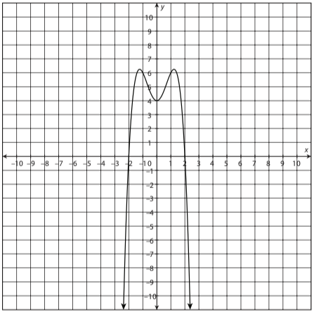
Guided Practice: Example 3, continued

Slide 56
Guided Practice: Example 3, continued
Analyze the table of values.
On a TI-83/84:
Step 1: Choose [TABLE]. Scroll up and down the table to view various points on the graph.
On a TI-Nspire:
Step 1: Choose [menu].
Navigate to 7: Table, 1: Split-Screen Table.
Arrow up and down the table to view various points on the graph.

Slide 57
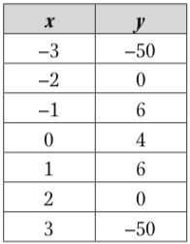
Guided Practice: Example 3, continued
Points include:

Slide 58
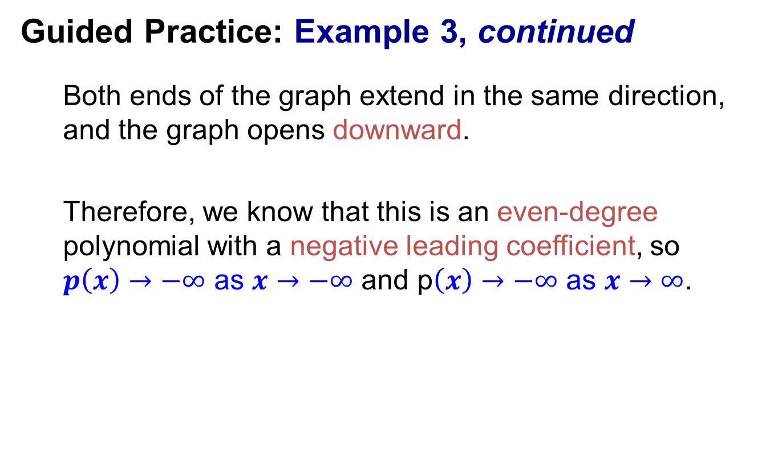
Guided Practice: Example 3, continued
Both ends of the graph extend in the same direction, and the graph opens downward.
Therefore, we know that this is an even-degree polynomial with a negative leading coefficient, so $p\left(x\right)→−∞$ as $x→−∞$ and p$\left(x\right)→−∞$ as $x→∞$.

Slide 59
Guided Practice: Example 3, continued
We can see from the graph that this function has three turning points.
It can be seen from the graph and the table of values that one turning point is at (0, 4).
x = 0 is less than the surrounding points, so it is a local (or relative) minimum.
(0,4)

Slide 60
Guided Practice: Example 3, continued
Two other approximate turning points are (–1, 6) and (1, 6).
x = –1 and 1 are greater than the surrounding points, so they are both local (or relative) maximums.
(-1,6)
(1,6)

Slide 61
Guided Practice: Example 3, continued
The graph intersects the x-axis at two points, indicating that there are two real roots of this function.
✔

Slide 62
Guided Practice
Example 4
Create a rough sketch of the graph of a sixth-degree polynomial function with a positive leading coefficient.

Slide 63
Guided Practice: Example 4, continued
Determine the end behavior of the possible function.
The function is a sixth-degree polynomial; therefore, it is an even-degree polynomial.
Both ends of the graphed function will extend
in the same direction.

Slide 64

Guided Practice: Example 4, continued
Because the leading coefficient is positive, both ends of the graphed function will extend upward.
Symbolically, $f\left(x\right)→∞$ as $x→−∞$ and $f\left(x\right)→∞$ as $x→∞$.

Slide 65
Guided Practice: Example 4, continued
Determine the maximum number of turns.
The maximum number of turns is defined by the degree of the polynomial minus 1.
maximum number of turns = n – 1
= 6 – 1
=5
A sixth-degree polynomial will have no more than 5 turning points.

Slide 66
Guided Practice: Example 4, continued
Determine the maximum number of real roots.
The maximum number of real roots, or x-intercepts, is equal to the degree of the polynomial.
This particular function will have no more than 6 real roots.

Slide 67
Guided Practice: Example 4, continued
Use the information from the previous steps to sketch a possible graph of a sixth-degree polynomial with a positive leading coefficient.
We have determined the following about a sixth- degree polynomial function with a positive leading coefficient:
Both ends of the function will extend upward.
It can have no more than 5 turning points.
It can have no more than 6 real roots.

Slide 68
Guided Practice: Example 4, continued
The following graph extends upward at both ends, has two turning points, and has two real roots.
It satisfies all the requirements of a sixth-degree polynomial function with a positive leading coefficient, so it is a possible graph.

Slide 69
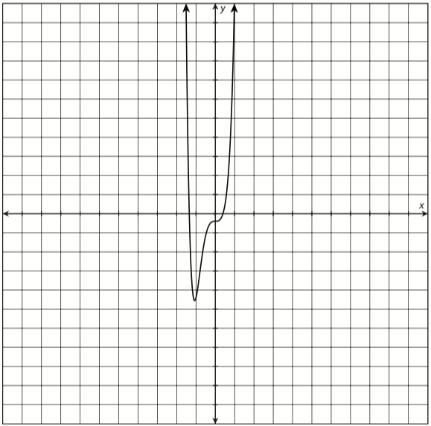
Guided Practice: Example 4, continued
✔

