Slide 1
Using Coordinates to Prove Geometric Theorems with Slope and Distance
Using Coordinates to Prove Geometric Theorems with Slope and Distance

Slide 2
Warm-Up
Using Coordinates to Prove Geometric Theorems with Slope and Distance

Slide 3
The graph to the right shows the average number of miles an airplane travels over the course of its flight.
What is the average rate of change per hour?
How many miles would the airplane travel in 9 hours?
Using Coordinates to Prove Geometric Theorems with Slope and Distance

Slide 4
What is the average rate of change per hour?
To calculate the average rate of change per hour, first locate any two points on the graph. Let’s use (60, 600) and (180, 1800).
Rate of change can be found using the slope formula:
Let (x₁, y₁) = (60, 600) and (x₂, y₂) = (180, 1800).
Using Coordinates to Prove Geometric Theorems with Slope and Distance

Slide 5
Rate of change = Original formula
Substitute values for x₁, x₂, y₁, and y₂.
Simplify.
= 10
The airplane is traveling 10 miles per minute.
Using Coordinates to Prove Geometric Theorems with Slope and Distance

Slide 6
The problem asks for the rate of change per hour. Convert minutes to hours.
The airplane travels an average of 600 miles per hour.
Using Coordinates to Prove Geometric Theorems with Slope and Distance

Slide 7
How many miles would the airplane travel in 9 hours?
Use the information found in question 1 to determine the number of miles the airplane would travel.
The airplane would travel an average of 5,400 miles in 9 hours.
Using Coordinates to Prove Geometric Theorems with Slope and Distance
Notes:
Connection to the Lesson
In this lesson, students will expand upon their understanding of slope.
Students will need to be comfortable with calculating slopes of given lines as they prove simple geometric theorems algebraically.

Slide 8
Instruction

Slide 9
Introduction
It is not uncommon for people to think of geometric figures, such as triangles and quadrilaterals, to be separate from algebra; however, we can understand and prove many geometric concepts by using algebra.
In this lesson, you will see how the distance formula originated with the Pythagorean Theorem, as well as how distance between points and the slope of lines can help us to determine specific geometric shapes.

Slide 10
Key Concepts
Calculating the Distance Between Two Points
To find the distance between two points on a coordinate plane, you have used the Pythagorean Theorem.
After creating a right triangle using each point as the end of the hypotenuse, you calculated the vertical height (a) and the horizontal height (b).
These lengths were then substituted into the Pythagorean Theorem (a² + b² = c²) and solved for c.
The result was the distance between the two points.

Slide 11
Key Concepts, continued
This is similar to the distance formula, which states the distance between points (x₁, y₁) and (x₂, y₂) is equal to .
Using the Pythagorean Theorem:
Find the length of a: |y₂ – y₁|.
Find the length of b: |x₂ – x₁|.
continued

Slide 12
Key Concepts, continued
Substitute these values into the Pythagorean Theorem.
Using the distance formula:

Slide 13
Key Concepts, continued
We will see in the Guided Practice an example that proves the calculations will result in the same distance.
Calculating Slope
To find the slope, or steepness of a line, calculate the change in y divided by the change in x using the formula .

Slide 14
Key Concepts, continued
Parallel and Perpendicular Lines
Parallel lines are lines in a plane that do not share any points and never intersect.
To prove that two lines are parallel, you must show that the slopes of both lines are equal.

Slide 15
Key Concepts, continued
Perpendicular lines are lines that intersect at a right angle (90˚). The slopes of perpendicular lines are always opposite reciprocals.
To prove that two lines are perpendicular, you must show that the slopes of both lines are opposite reciprocals.
When the slopes are multiplied, the result will always be –1.
Horizontal and vertical lines are always perpendicular to each other.

Slide 16
Common Errors/Misconceptions
incorrectly using the x- and y-coordinates in the distance formula
subtracting negative coordinates incorrectly
incorrectly calculating the slope of a line
incorrectly determining the slope of a line that is perpendicular to a given line
assuming lines are parallel or perpendicular based on appearance only
making determinations about the type of polygon without making all the necessary calculations

Slide 17
Guided Practice
Example 1
Calculate the distance between the points (4, 9) and (–2, 6) using both the Pythagorean Theorem and the distance formula.

Slide 18
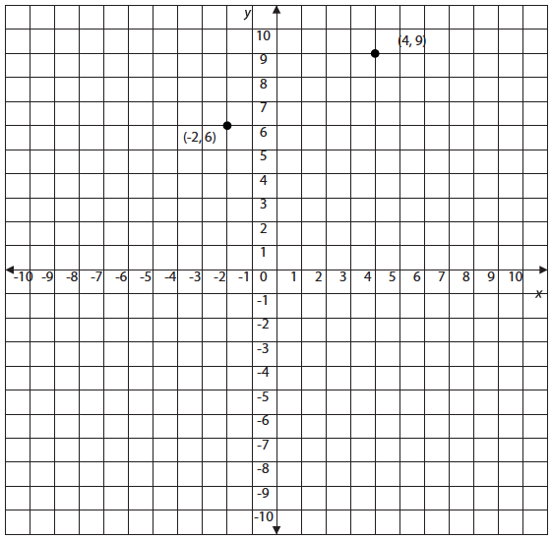
Guided Practice: Example 1, continued
To use the Pythagorean Theorem, first plot the points in a coordinate system.

Slide 19
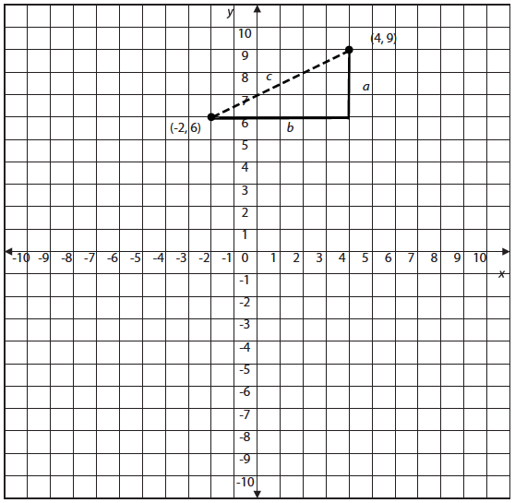
Guided Practice: Example 1, continued
Draw the lines to form a right triangle, using each point as an endpoint of the hypotenuse.

Slide 20
Guided Practice: Example 1, continued
Calculate the length of the vertical side, a, of the right triangle.
Let (x₁, y₁) = (4, 9) and (x₂, y₂) = (-2, 6).
The length of side a is 3 units.

Slide 21
Guided Practice: Example 1, continued
Calculate the length of the horizontal side, b, of the right triangle.
The length of side b is 6 units.

Slide 22
Guided Practice: Example 1, continued
Use the Pythagorean Theorem to calculate the length of the hypotenuse, c.
The distance between the points (4, 9) and (-2, 6) is or approximately 6.7 units.
Pythagorean Theorem
Substitute values for a and b.
Simplify each term.
Simplify.
Take the square root of both sides of the equation.

Slide 23
Guided Practice: Example 1, continued
Now use the distance formula between the same points, (4, 9) and (-2, 6).
Let (x₁, y₁) = (4, 9) and (x₂, y₂) = (-2, 6).
The distance between the points (4, 9) and (-2, 6) is units, or approximately 6.7 units.
Distance Formula
Substitute (4, 9) and (-2, 6).
Simplify.
Evaluate squares.
Simplify.
✔
Both calculations will produce the same results each time.

Slide 24
Guided Practice
Example 2
Determine if the line through the points (–8, 5) and (–5, 3) is parallel to the line through the points (1, 3) and (4, 1).

Slide 25
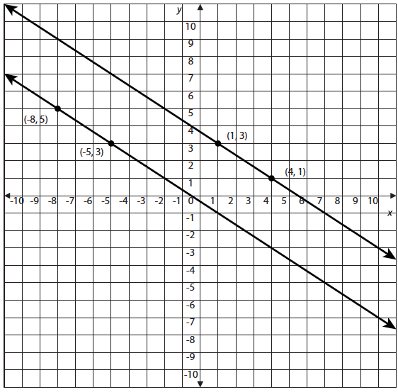
Guided Practice: Example 2, continued
Plot the lines on a coordinate plane.

Slide 26
Guided Practice: Example 2, continued
Calculate the slope of the line through the points (-8, 5) and (-5, 3).
Let (x₁, y₁) = (-8, 5) and (x₂, y₂) = (-5, 3).
Substitute these values into the slope formula.
The slope of the line through the points (-8, 5) and (-5, 3) is .
Original Formula
Substitute (x₁, y₁) and (x₂, y₂).
Simplify.

Slide 27
Guided Practice: Example 2, continued
Calculate the slope of the line through the points (1, 3) and (4, 1).
Let (x₁, y₁) = (1, 3) and (x₂, y₂) = (4, 1).
Substitute these values into the slope formula.
The slope of the line through the points (1, 3) and (4, 1) is .
Original Formula
Substitute (x₁, y₁) and (x₂, y₂).
Simplify.

Slide 28
Guided Practice: Example 2, continued
Determine if the lines are parallel.
Parallel lines have equal slopes.
The slope of each line is ; therefore, the lines are parallel.
✔

Slide 29
Guided Practice
Example 3
Determine if the line through the points (0, 8) and (4, 9) is perpendicular to the line through the points (–9, 10) and (–8, 6).

Slide 30
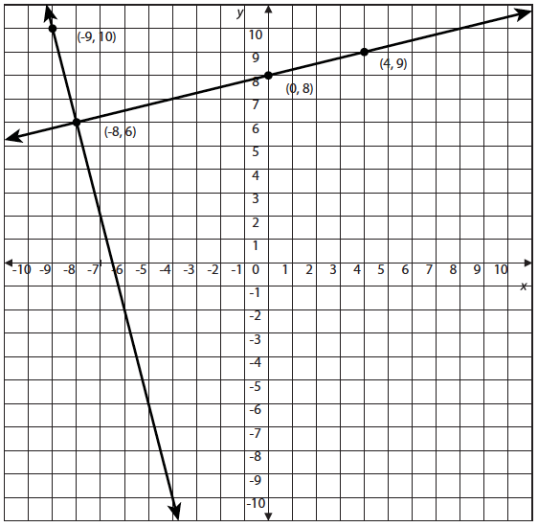
Guided Practice: Example 3, continued
Plot the lines on a coordinate plane.

Slide 31
Guided Practice: Example 3, continued
Calculate the slope of the line through the points (0, 8) and (4, 9).
Let (x₁, y₁) = (0, 8) and (x₂, y₂) = (4, 9).
Substitute these values into the slope formula.
The slope of the line through the points (0, 8) and (4, 9) is .
Original Formula
Substitute (x₁, y₁) and (x₂, y₂).
Simplify.

Slide 32
Guided Practice: Example 3, continued
Calculate the slope of the line through the points (-9, 10) and (-8, 6).
Let (x₁, y₁) = (-9, 10) and (x₂, y₂) = (-8, 6).
Substitute these values into the slope formula.
The slope of the line through the points (-9, 10) and (-8, 6) is -4.
Original Formula
Substitute (x₁, y₁) and (x₂, y₂).
Simplify.

Slide 33
Guided Practice: Example 3, continued
Determine if the lines are perpendicular.
Perpendicular lines have slopes that are opposite reciprocals.
The slope of the first line is .
The reciprocal of is or 4.
The opposite of 4 is -4.
The slope of the second line is -4.
The product of the two slopes is -1.
The slopes of the lines are opposite reciprocals; therefore, the lines are perpendicular.
✔

Slide 34
Guided Practice
Example 4
A right triangle is defined as a triangle with 2 sides that are perpendicular. Triangle ABC has vertices A (–4, 8), B (–1, 2), and C (7, 6). Determine if this triangle is a right triangle. When disproving a figure, you only need to show one condition is not met.

Slide 35
Guided Practice: Example 4, continued
Plot the triangle on a coordinate plane.

Slide 36
Guided Practice: Example 4, continued
Calculate the slope of each side using the general slope formula, .

Slide 37
Guided Practice: Example 4, continued
Observe the slopes of each side.
The slope of is –2 and the slope of is .
These slopes are opposite reciprocals of each other, so we know that these two sides are perpendicular.

Slide 38
Guided Practice: Example 4, continued
Make connections.
Right triangles have two sides that are perpendicular.
Triangle ABC has two sides that are perpendicular; therefore, it is a right triangle.
✔

Slide 39

Guided Practice: Example 4, continued
Using Coordinates to Prove Geometric Theorems with Slope and Distance
Notes:
http://www.walch.com/ei/00123

Slide 40
Guided Practice
Example 5
A square is a quadrilateral with two pairs of parallel opposite sides, consecutive sides that are perpendicular, and all sides congruent, meaning they have the same length. Quadrilateral ABCD has vertices A (–1, 2),
B (1, 5), C (4, 3), and D (2, 0). Determine if this quadrilateral is a square.

Slide 41
Guided Practice: Example 5, continued
Plot the quadrilateral on a coordinate plane.

Slide 42
Guided Practice: Example 5, continued
First show the figure has two pairs of parallel opposite sides.
Calculate the slope of each side using the general slope formula, .

Slide 43
Guided Practice: Example 5, continued

Slide 44
Guided Practice: Example 5, continued
Observe the slopes of each side.
The side opposite is . The slopes of these sides are the same.
The side opposite is . The slopes of these sides are the same.
The quadrilateral has two pairs of parallel opposite sides.

Slide 45
Guided Practice: Example 5, continued
and are consecutive sides. The slopes of the sides are opposite reciprocals.
and are consecutive sides. The slopes of the sides are opposite reciprocals.
and are consecutive sides. The slopes of the sides are opposite reciprocals.
and are consecutive sides. The slopes of the sides are opposite reciprocals.
Consecutive sides are perpendicular.

Slide 46
Guided Practice: Example 5, continued
Show that the quadrilateral has four congruent sides.
Find the length of each side using the distance formula, .

Slide 47
Guided Practice: Example 5, continued
The lengths of all 4 sides are congruent.

Slide 48
Guided Practice: Example 5, continued
Make connections.
A square is a quadrilateral with two pairs of parallel opposite sides, consecutive sides that are perpendicular, and all sides congruent.
Quadrilateral ABCD has two pairs of parallel opposite sides, the consecutive sides are perpendicular, and all the sides are congruent. It is a square.
✔

Slide 49
Guided Practice: Example 5, continued
Using Coordinates to Prove Geometric Theorems with Slope and Distance
Notes:
http://www.walch.com/ei/00124

