Slide 1
Introduction
When a series of rigid motions is performed on a triangle, the result is a congruent triangle. When triangles are congruent, the corresponding parts of the triangles are also congruent. It is also true that if the corresponding parts of two triangles are congruent, then the triangles are congruent. It is possible to determine if triangles are congruent by measuring and comparing each angle and side, but this can take time. There is a set of congruence criteria that lets us determine whether triangles are congruent with less information.

Slide 2
Key Concepts
The criteria for triangle congruence, known as triangle congruence statements, provide the least amount of information needed to determine if two triangles are congruent.
Each congruence statement refers to the corresponding parts of the triangles.
By looking at the information about each triangle, you can determine whether the triangles are congruent.

Slide 3
Key Concepts, continued
The side-side-side (SSS) congruence statement states that if three sides of one triangle are congruent to three sides of another triangle, then the two triangles are congruent.
If it is known that the corresponding sides are congruent, it is understood that the corresponding angles are also congruent.

Slide 4
Key Concepts, continued
The side-angle-side (SAS) congruence statement states that if two sides and the included angle of one triangle are congruent to two sides and the included angle of another triangle, then the two triangles are congruent.
The included angle is the angle that is between the two congruent sides.

Slide 5
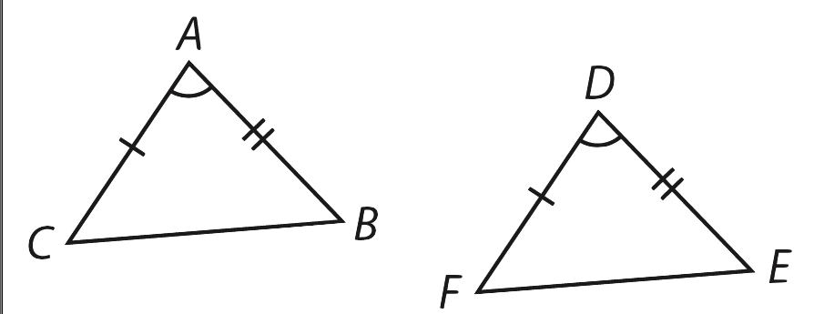
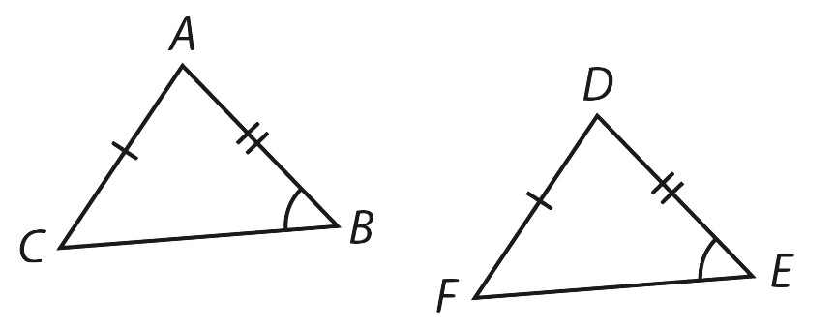
Key Concepts, continued
Included angle | Non-included angle
∠A is included between and . ∠D is included between and . | ∠B is NOT included between and . ∠E is NOT included between and .

Slide 6
Key Concepts, continued
The angle-side-angle congruence statement, or ASA, states that if two angles and the included side of one triangle are congruent to two angles and the included side of another triangle, then the two triangles are congruent.
The included side is the side that is between the two congruent angles.

Slide 7
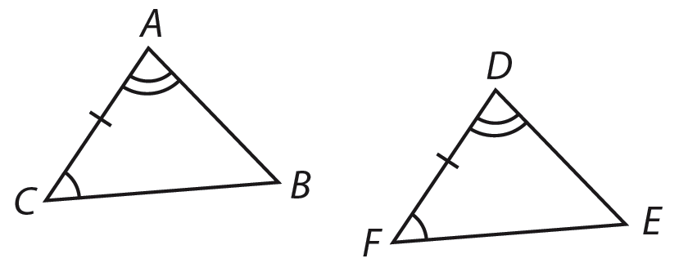
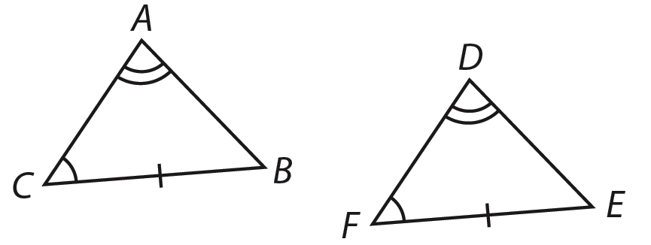
Key Concepts, continued
Included side | Non-included side
is included between ∠C and ∠A. is included between ∠F and ∠D. | is NOT included between ∠C and ∠A. is NOT included between ∠F and ∠D.

Slide 8
Key Concepts, continued
A fourth congruence statement, angle-angle-side (AAS), states that if two angles and a non-included side of one triangle are congruent to the corresponding two angles and side of a second triangle, then the triangles are congruent.
There is also one more congruence statement, hypotenuse-leg (HL), that applies only to right triangles. The HL theorem states that, given 2 right triangles, if the hypotenuse and one leg of one right triangle are congruent to the corresponding sides of the other right triangle, then the triangles are congruent.

Slide 9
Key Concepts, continued
This lesson will focus on the first three congruence statements: SSS, SAS, and ASA.
The diagram on the next slide compares these three congruence statements.

Slide 10
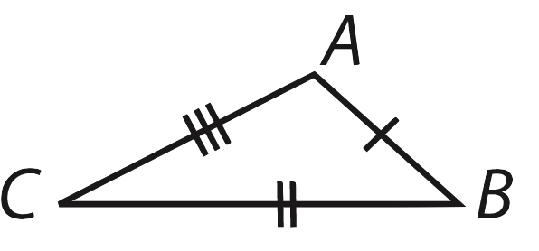
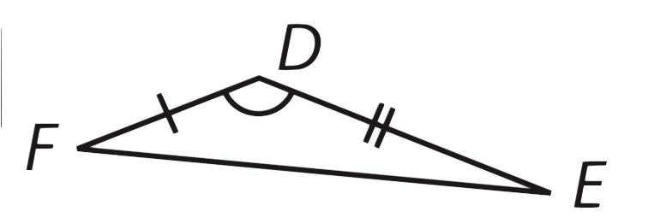
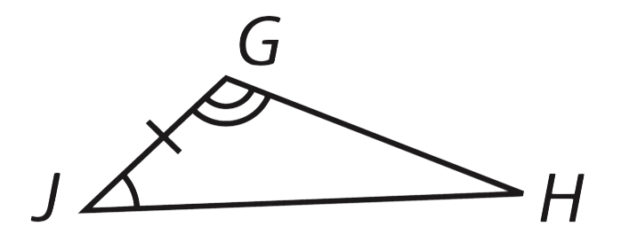
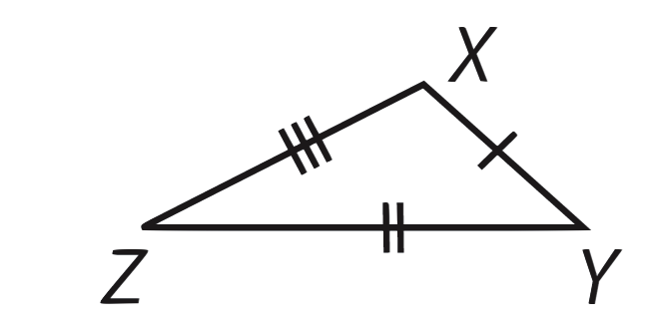
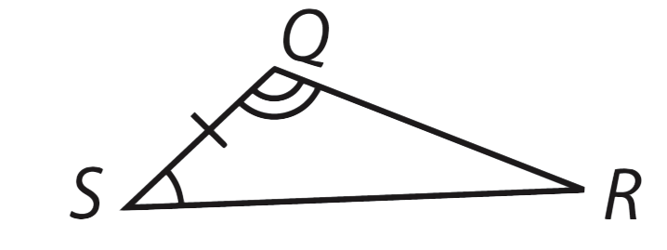
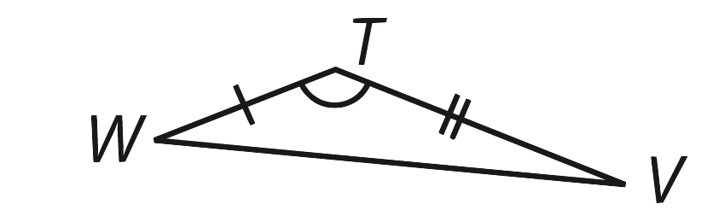
Key Concepts, continued
Side-Side-Side (SSS) | Side-Angle-Side (SAS) | Angle-Side-Angle (ASA)

Slide 11
Common Errors/Misconceptions
misidentifying included sides and angles, resulting in the wrong congruence statement
misreading congruency symbols of triangles
changing the order of named triangles, causing parts to be incorrectly interpreted as congruent

Slide 12
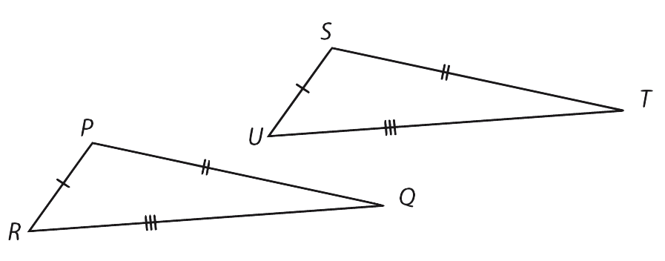
Guided Practice
Example 1
Determine which congruence statement, if any, can be used to show that and are congruent.

Slide 13
Guided Practice: Example 1, continued
Determine which components of the triangles are congruent.
According to the diagram, , , and
Corresponding side lengths of the two triangles are identified as congruent.

Slide 14
Guided Practice: Example 1, continued
Determine if this information is enough to state that all six corresponding parts of the two triangles are congruent.
It is given that all side lengths of the two triangles are congruent; therefore, all their angles are also congruent.
Because all six corresponding parts of the two triangles are congruent, then the two triangles are congruent.

Slide 15
Guided Practice: Example 1, continued
Summarize your findings.
because of the congruence statement
side-side-side (SSS).
✔

Slide 16

Guided Practice: Example 1, continued
Notes:
http://www.walch.com/ei/00121

Slide 17
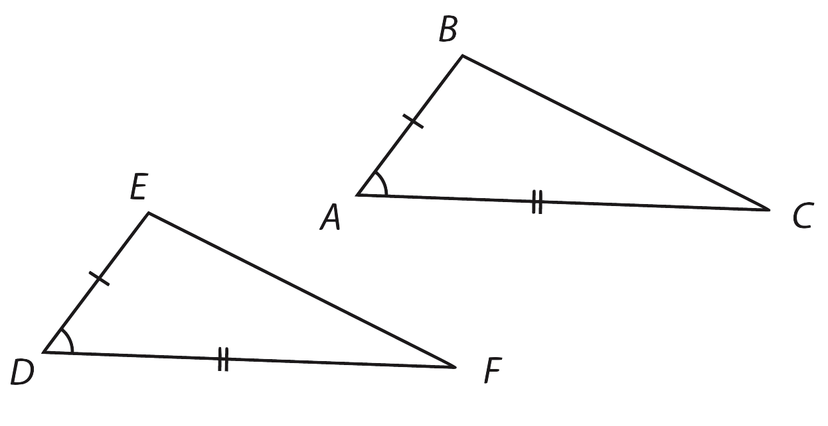
Guided Practice
Example 2
Determine which congruence statement, if any, can be used to show that and are congruent.

Slide 18
Guided Practice: Example 2, continued
Determine which components of the triangles are congruent.
According to the diagram, , , and
Two corresponding side lengths of the two triangles and one corresponding angle are identified as congruent.

Slide 19
Guided Practice: Example 2, continued
Determine if this information is enough to state that all six corresponding parts of the two triangles are congruent.
Notice that the congruent angles are included angles, meaning the angles are between the sides that are marked as congruent.
It is given that two sides and the included angle are congruent, so the two triangles are congruent.

Slide 20
Guided Practice: Example 2, continued
Summarize your findings.
because of the congruence statement
side-angle-side (SAS).
✔

Slide 21
Guided Practice: Example 2, continued
Notes:
http://www.walch.com/ei/00122

