Slide 1
Triangle Congruency
Triangle Congruency

Slide 2
Warm-Up
Triangle Congruency

Slide 3
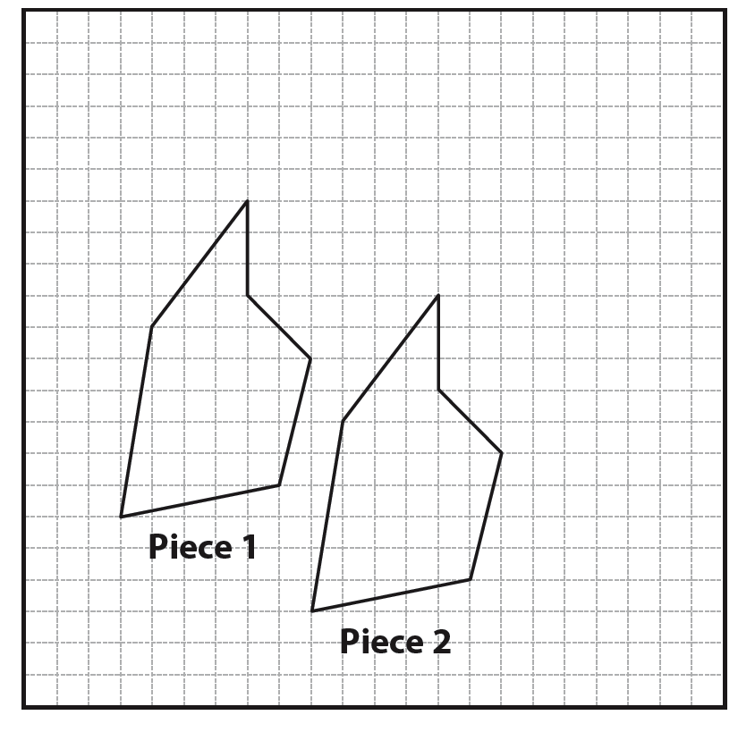
Cutting mats used in crafting are similar to coordinate planes, except that the axes are labeled with inches or centimeters, rather than positive and negative numbers. Juliet is in the middle of a sewing project and has laid out two congruent pieces of fabric on her cutting mat.
Triangle Congruency

Slide 4
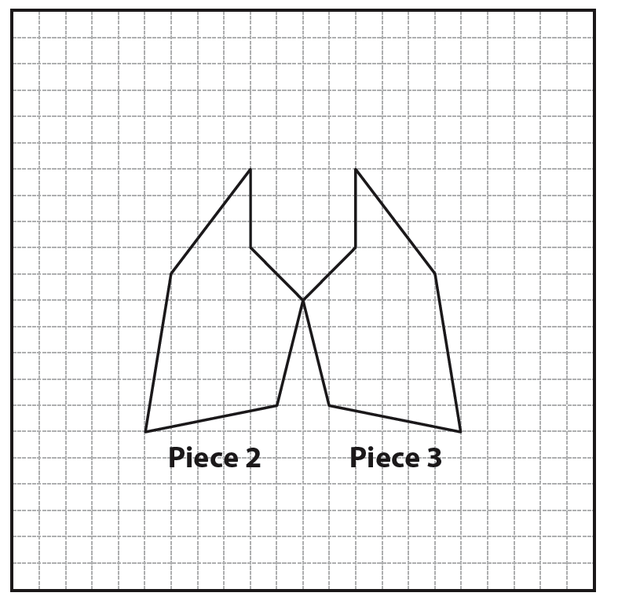
What is the series of transformations that has taken place between Piece 1 and Piece 2?
Juliet takes Piece 1 off the mat. She places a third piece of fabric on the cutting mat.
Triangle Congruency
Notes:
Common Core State Standard: G–CO.7

Slide 5
What is the series of transformations that has taken place between Piece 2 and Piece 3?
Is Piece 3 congruent to Piece 1? Explain your reasoning.
Triangle Congruency

Slide 6
What is the series of transformations that has taken place between Piece 1 and Piece 2?
Piece 1 was slid, or translated, to the right 6 units.
Piece 1 was also translated down 3 units.
The position of Piece 2 is the result of a horizontal translation of 6 units to the right and a vertical translation of 3 units down.
Triangle Congruency

Slide 7
What is the series of transformations that has taken place between Piece 2 and Piece 3?
Piece 3 is the mirror image of Piece 2.
The position of Piece 3 is the reflection of Piece 2 over a vertical line.
Triangle Congruency

Slide 8
Is Piece 3 congruent to Piece 1? Explain your reasoning.
Piece 3 is congruent to Piece 1.
A translation is a congruency transformation, so Piece 1 is congruent to Piece 2.
A reflection is also a congruency transformation, so Piece 3 is congruent to Piece 2.
A series of congruency transformations results in a congruent figure, so Piece 3 is congruent to Piece 1.
Triangle Congruency
Notes:
Connection to the Lesson
• Students will use the definition of congruence in terms of rigid motions to identify congruent parts of triangles.

Slide 9
Instruction

Slide 10
Introduction
If a rigid motion or a series of rigid motions, including translations, rotations, or reflections, is performed on a triangle, then the transformed triangle is congruent to the original.
When two triangles are congruent, the corresponding angles have the same measures and the corresponding sides have the same lengths.
It is possible to determine whether triangles are congruent based on the angle measures and lengths of the sides of the triangles.

Slide 11
Key Concepts
To determine whether two triangles are congruent, you must observe the angle measures and side lengths of the triangles.
When a triangle is transformed by a series of rigid motions, the angles are images of each other and are called corresponding angles.
Corresponding angles are a pair of angles in a similar position.

Slide 12
Key Concepts, continued
If two triangles are congruent, then any pair of corresponding angles is also congruent.
When a triangle is transformed by a series of rigid motions, the sides are also images of each other and are called corresponding sides.
Corresponding sides are the sides of two figures that lie in the same position relative to the figure.
If two triangles are congruent, then any pair of corresponding sides is also congruent.

Slide 13
Key Concepts, continued
Congruent triangles have three pairs of corresponding angles and three pairs of corresponding sides, for a total of six pairs of corresponding parts.
If two or more triangles are proven congruent, then all of their corresponding parts are congruent as well.
This postulate is known as Corresponding Parts of Congruent Triangles are Congruent (CPCTC).
A postulate is a true statement that does not require a proof.

Slide 14
Key Concepts, continued
The corresponding angles and sides can be determined by the order of the letters.
If is congruent to , the angles of the two triangles correspond in the same order as they are named.
Use the symbol → to show that two parts are corresponding.
Angle A → Angle D; they are equivalent.
Angle B → Angle E; they are equivalent.
Angle C → Angle F; they are equivalent.

Slide 15
Key Concepts, continued
The corresponding angles are used to name the corresponding sides.
; they are equivalent.
; they are equivalent.
; they are equivalent.

Slide 16
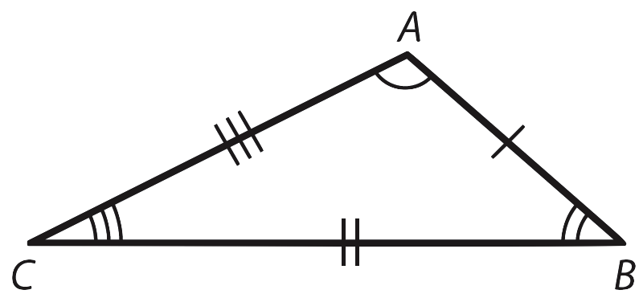
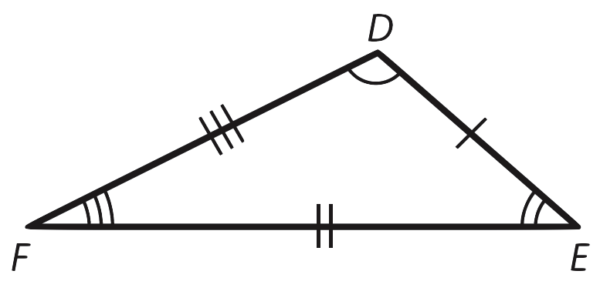
Key Concepts, continued
Observe the diagrams of and .

Slide 17
Key Concepts, continued
By observing the angles and sides of two triangles, it is possible to determine if the triangles are congruent.
Two triangles are congruent if the corresponding angles are congruent and corresponding sides are congruent.
Notice the number of tick marks on each side of the triangles in the diagram.
The tick marks show the sides that are congruent.

Slide 18
Key Concepts, continued
Compare the number of tick marks on the sides of
to the tick marks on the sides of .
Match the number of tick marks on one side of one triangle to the side with the same number of tick marks on the second triangle.
and each have one tick mark, so the two sides are congruent.
and each have two tick marks, so the two sides are congruent.
and each have three tick marks, so the two sides are congruent.

Slide 19
Key Concepts, continued
The arcs on the angles show the angles that are congruent.
Compare the number of arcs on the angles of to the number of arcs on the angles of .
Match the arcs on one angle of one triangle to the angle with the same number of arcs on the second triangle.
∠A and ∠D each have one arc, so the two angles are congruent.
∠B and ∠E each have two arcs, so the two angles are congruent.
∠C and ∠F each have three arcs, so the two angles are congruent.

Slide 20
Key Concepts, continued
If the sides and angles are not labeled as congruent, you can use a ruler and protractor or construction methods to measure each of the angles and sides.

Slide 21
Common Errors/Misconceptions
incorrectly identifying corresponding parts of triangles
assuming corresponding parts indicate congruent parts
assuming alphabetical order indicates congruence

Slide 22
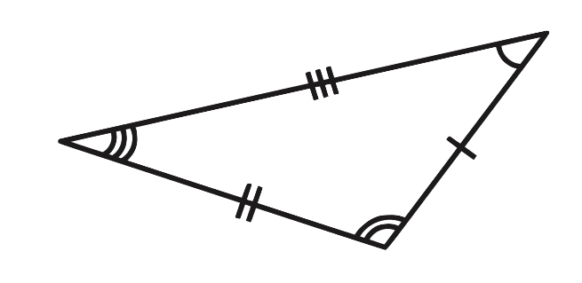
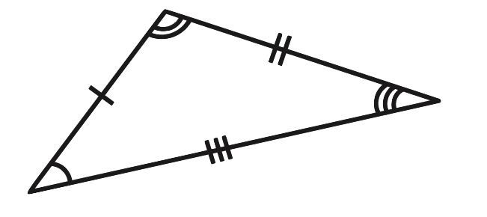
Guided Practice
Example 1
Use corresponding parts to identify the congruent triangles.
R
M
A
T
J
V

Slide 23
Guided Practice: Example 1, continued
Match the number of tick marks to identify the corresponding congruent sides.
and each have one tick mark; therefore, they are corresponding and congruent.
and each have two tick marks; therefore, they are corresponding and congruent.
and each have three tick marks; therefore, they are corresponding and congruent.

Slide 24
Guided Practice: Example 1, continued
Match the number of arcs to identify the corresponding congruent angles.
∠R and ∠J each have one arc; therefore, the two angles are corresponding and congruent.
∠V and ∠M each have two arcs; therefore, the two angles are corresponding and congruent.
∠A and ∠T each have three arcs; therefore, the two angles are corresponding and congruent.

Slide 25
Guided Practice: Example 1, continued
Order the congruent angles to name the congruent triangles.
is congruent to , or .
It is also possible to identify the congruent triangles as , or even ; whatever order chosen, it is important that the order in which the vertices are listed in the first triangle matches the congruency of the vertices in the second triangle.

Slide 26
Guided Practice: Example 1, continued
Order the congruent angles to name the congruent triangles.
For instance, it is not appropriate to say
that is congruent to because
∠R is not congruent to ∠M.
✔

Slide 27

Guided Practice: Example 1, continued
Notes:
http://www.walch.com/ei/00119

Slide 28
Guided Practice
Example 2
Name the corresponding angles and sides of the congruent triangles.

Slide 29
Guided Practice: Example 2, continued
Identify the congruent angles.
The names of the triangles indicate the angles that are corresponding and congruent.
Begin with the first letter of each name.
Identify the first set of congruent angles.
∠B is congruent to ∠H.
Identify the second set of congruent angles.
∠D is congruent to ∠J.
Identify the third set of congruent angles.
∠F is congruent to ∠L.

Slide 30
Guided Practice: Example 2, continued
Identify the congruent sides.
The names of the triangles indicate the sides that are corresponding and congruent.
Begin with the first two letters of each name.
Identify the first set of congruent sides.
is congruent to .
Identify the second set of congruent sides.
is congruent to .
Identify the third set of congruent sides.
is congruent to .
✔

Slide 31
Guided Practice: Example 2, continued
Notes:
http://www.walch.com/ei/00120

Slide 32
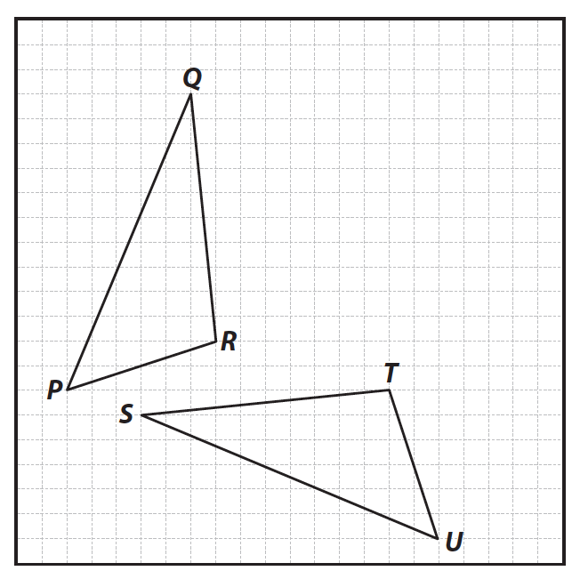
Guided Practice
Example 3
Use construction tools to determine if the triangles are congruent. If they are, name the congruent triangles and corresponding angles and sides.

Slide 33
Guided Practice: Example 3, continued
Use a compass to compare the length of each side.
Begin with the shortest sides, and .
Set the sharp point of the compass on point P and extend the pencil of the compass to point R.
Without changing the compass setting, set the sharp point of the compass on point U and extend the pencil of the compass to point T.
The compass lengths match, so the length of is equal to ; therefore, the two sides are congruent.

Slide 34
Compare the longest sides, and .
Set the sharp point of the compass on point P and extend the pencil of the compass to point Q.
Without changing the compass setting, set the sharp point of the compass on point U and extend the pencil of the compass to point S.
The compass lengths match, so the length of is equal to ; therefore, the two sides are congruent.

Slide 35
Compare the last pair of sides, and .
Set the sharp point of the compass on point Q and extend the pencil of the compass to point R.
Without changing the compass setting, set the sharp point of the compass on point S and extend the pencil of the compass to point T.
The compass lengths match, so the length of is equal to ; therefore, the two sides are congruent.

Slide 36
Guided Practice: Example 3, continued
Use a compass to compare the measure of each angle.
Begin with the largest angles, ∠R and ∠T .
Set the sharp point of the compass on point R and create a large arc through both sides of ∠R .
Without adjusting the compass setting, set the sharp point on point T and create a large arc through both sides of ∠T .

Slide 37
Set the sharp point of the compass on one point of intersection and open it so it touches the second point of intersection.
Use this setting to compare the distance between the two points of intersection on the second triangle.
The measure of ∠R is equal to the measure of ∠T ; therefore, the two angles are congruent.
The measure of ∠Q is equal to the measure of ∠S ; therefore, the two angles are congruent.
The measure of ∠P is equal to the measure of ∠U ; therefore, the two angles are congruent.

Slide 38
Guided Practice: Example 3, continued
Summarize your findings.
The corresponding and congruent sides include:
The corresponding and congruent angles include:
✔
Therefore,

