Slide 1
Graphing Logarithmic Functions
Graphing Logarithmic Functions

Slide 2
Warm-Up
Graphing Logarithmic Functions

Slide 3
In preparation for the upcoming Mathlete Tournament, Mrs. Blake graphed two functions as shown. She asked her students to use this graph to compare the domain and range of each function.
Graphing Logarithmic Functions

Slide 4
Over which restricted domain are the values of f(x) < g(x)?
Over which restricted domain are the values of f(x) > g(x)?
At what domain value is f(x) = g(x)?
What are the ranges of f(x) and g(x)?
Graphing Logarithmic Functions

Slide 5
Over which restricted domain are the values of f(x) < g(x)?
As the graph shows, the restricted domain over which f(x) < g(x) is (0, 1).
Graphing Logarithmic Functions

Slide 6

Over which restricted domain are the values of f(x) > g(x)?
As the graph shows, the restricted domain over which f(x) > g(x) is (1, $∞$).
Graphing Logarithmic Functions

Slide 7
At what domain value is f(x) = g(x)?
As the graph shows, f(x) = g(x) at x = 1.
Graphing Logarithmic Functions

Slide 8

What are the ranges of f(x) and g(x)?
Both functions have a range of $(–∞, ∞$).
Graphing Logarithmic Functions
Notes:
Connection to the Lesson
Students will identify the domain and restricted domain(s) of a logarithmic function.
Students will compare the graphs of logarithmic functions and identify the restricted domain(s) over which the functions can be compared.
Students will identify the range of a logarithmic function.
Students will describe how the value of a logarithmic function changes as the domain values approach the upper and lower bounds of the domain.

Slide 9
Instruction

Slide 10
Introduction
The functions f(x) = a • log_{b} c, g(x) = a + b • log_{c} d, and h(x) = a • log_{d} c are “families” of logarithmic functions.
The graphs of logarithmic functions exhibit patterns that can help in identifying these functions when the algebraic function is not present.

Slide 11
Key Concepts
Logarithmic functions or the logarithmic terms within logarithmic functions are equal to 0 when their arguments equal 1.
Recall that the argument is the result of raising the base of a logarithm to the power of the logarithm, so that b is the argument of the logarithm log_{a} b = c.

Slide 12
Key Concepts, continued
For example, let’s look at f(x) = 30 • ln x at x = 1:
f(1) = 30 • ln 1
= 30 • 0
= 0

Slide 13
Key Concepts, continued
For another example, let's look at the function g(x) = –250 + 6 • log₄ (x + 4).
Solve for x = –3:
g(–3) = –250 + 6 • log₄ [(–3) + 4]
g(–3) = –250 + 6 • log₄ (1)
g(–3) = –250 + 0 = –250
Notice that the argument for each example was equal to 1.

Slide 14
Key Concepts, continued
The values of logarithmic functions or their logarithmic terms approach positive or negative infinity as the argument of the logarithmic term approaches 0.
For example, in the function f(x) = –ln x, f(0.1) is about 2.3, but f(0.001) is almost 7.
If x = 10^{–12}, f(x) is almost 28. The function value increases continuously as the value of x decreases.

Slide 15
Key Concepts, continued
A graphing calculator will also show this function behavior.
By looking at a variety of function values of interest (such as very small values of x), it is possible to see trends in the changing values of the function.
Examine very small values of x by adjusting the axis scales or using the calculator’s trace feature.
Similarly, the value of logarithmic functions or their logarithmic terms as x becomes very large, positively or negatively, can be seen by substituting values for x or by using a calculator to calculate the values.

Slide 16
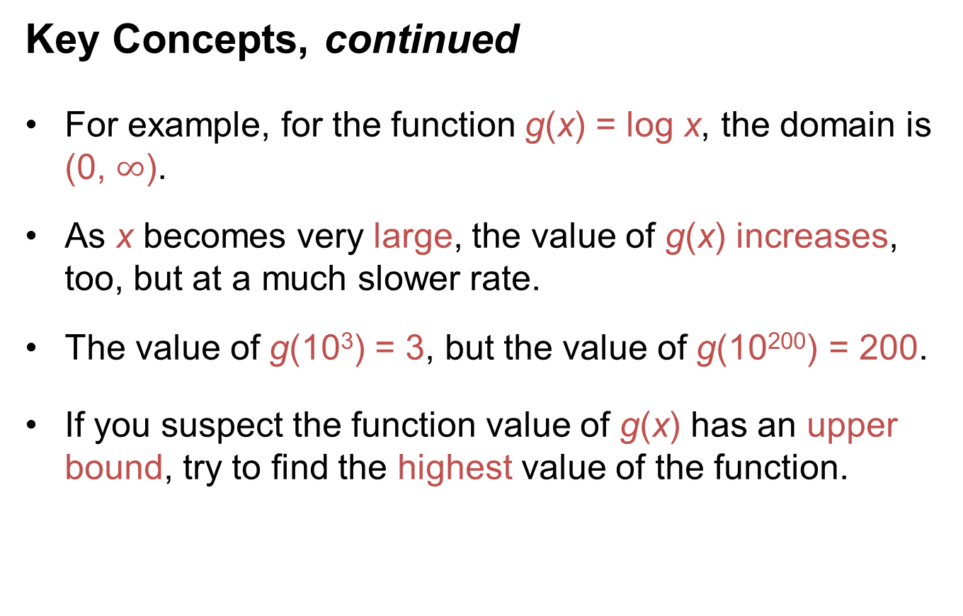
Key Concepts, continued
For example, for the function g(x) = log x, the domain is (0, $∞$).
As x becomes very large, the value of g(x) increases, too, but at a much slower rate.
The value of g(10³) = 3, but the value of g(10²⁰⁰) = 200.
If you suspect the function value of g(x) has an upper bound, try to find the highest value of the function.

Slide 17
Key Concepts, continued
Follow these basic rules to compare logarithmic functions.
However, use caution when defining domains: positive, negative, or zero domain values can result in an undefined function, or change the ordering in a comparison of function values.

Slide 18
Key Concepts, continued
Powers, Products, Quotients, Roots, and Sums of Logarithmic Functions
Families of logarithmic functions are grouped according to the operations shown in the equations of the functions.
In real-world problems, you can calculate such combined operations with logarithmic functions best by approximation techniques or with calculators.
Each example that follows shows how different operations affect the graph of a logarithmic function.

Slide 19
Key Concepts, continued
f(x) = a • log_{b} c
Compare the graphs of three functions of the form f(x) = a • log_{b} c.

Slide 20
Key Concepts, continued
All three graphs pass through the point (1, 0) because any number raised to the 0 power (the y-value) is equal to 1 (the x-value).
The coefficient in front of each logarithm multiplies the logarithmic value at that value of x by the magnitude of the coefficient.

Slide 21
Key Concepts, continued
This means that h(x) = 3 • f(x) = 3 • log x, and g(x) can be determined as follows.
g(x) = 2 • log x

Slide 22
Key Concepts, continued
f(x) = a + b • log_{c} d
Observe the graphs of three functions of the form f(x) = a + b • log_{c} d.

Slide 23
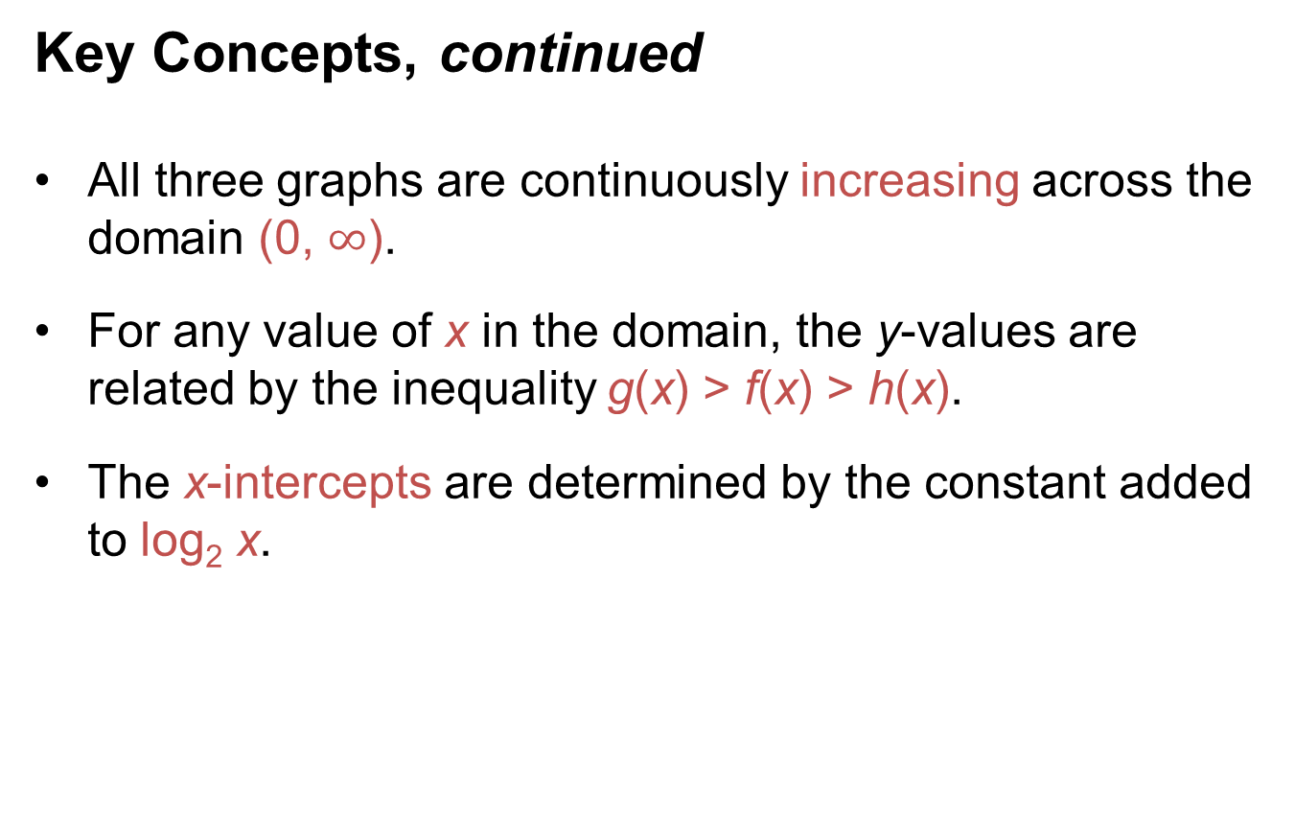
Key Concepts, continued
All three graphs are continuously increasing across the domain (0, $∞$).
For any value of x in the domain, the y-values are related by the inequality g(x) > f(x) > h(x).
The x-intercepts are determined by the constant added to log₂ x.

Slide 24
Key Concepts, continued
f(x) = a • log_{b} c and
g(x) = a • log_{d} c
Compare the graphs of three functions with different bases.

Slide 25
Key Concepts, continued
All three functions contain the point (1, 0), since the logarithm of any base to the power of 0 is equal to 1.
As the graphs show, the functions are related by the inequality g(x) > h(x) > f(x) for a specific positive value of x.
Comparing the bases of the three functions reveals that they are ordered in the opposite “direction” from the functions: 2 < 5 < 10 for g(x) > h(x) > f(x).

Slide 26
Key Concepts, continued
Alternately, as x increases, the powers of the smaller bases grow larger in order to remain proportional with larger bases raised to the same power.
For example, for x = 8,
g(8) = 3
h(8) ≈ 1.29
f(8) ≈ 0.90.

Slide 27
Common Errors/Misconceptions
confusing the domain and range in a logarithmic function problem
using an argument in a logarithmic term that is less than 0
failing to check all of the domain and extreme-value options in graphing one or more logarithmic functions; e.g., intercepts and function values for upper and lower bounds of domains

Slide 28
Guided Practice
Example 1
Sketch the graphs of the functions f(x) = 2 • log₂ x and g(x) = 2 – log₂ x on a coordinate plane. Describe
the end behavior of each function.

Slide 29
Guided Practice: Example 1, continued
Determine function values for f(1) and g(1) and write the results as ordered pairs.
Substitute x = 1 into each function and solve.
Write each point as an ordered pair.
For f(x): (1, 0)
For g(x): (1, 2)
f(1) = 2 • log₂ (1)
= 2 • 0
=0
g(1) = 2 – log₂ (1)
= 2 – 0
=2

Slide 30
Guided Practice: Example 1, continued
Find the value(s) of x at which f(x) = g(x).
This will reveal any point(s) of intersection, or solutions, of the system of equations.
2 • log₂ x = 2 – log₂ x Set the functions equal to each other.
3 • log₂ x = 2 Add log₂ x to both sides.
Divide both sides by 3.
Simplify.
Using a calculator, the approximate value of x is 1.6.

Slide 31
Guided Practice: Example 1, continued
Find the function value at which the functions are equal.
Substitute the approximate value of x from step 2 into each function.

Slide 32
Guided Practice: Example 1, continued
Write the approximate point at which the functions intersect.
Since the value of x is rounded, the functions intersect at approximately or

Slide 33
Guided Practice: Example 1, continued
Determine additional points for sketching the graph of each function.
Choose values of x that can be evaluated easily.
Let x = 0.25, 0.5, 2, and 4.

Slide 34
Guided Practice: Example 1, continued
Solve f(x) for each given value.
f(0.25) = 2 • log₂ (0.25)
= 2 • –2
= –4
f(2) = 2 • log₂ (2)
= 2 • 1
= 2
f(0.5) = 2 • log₂ (0.5)
= 2 • –1
= –2
f(4) = 2 • log₂ (4)
= 2 • 2
= 4

Slide 35
Guided Practice: Example 1, continued
Solve g(x) for each given value.
g(0.25) = 2 – log₂ (0.25)
= 2 – (–2)
= 4
g(2) = 2 – log₂ (2)
= 2 – 1
= 1
g(0.5) = 2 – log₂ (0.5)
= 2 – (–1)
= 3
g(4) = 2 – log₂ (4)
= 2 – 2
= 0

Slide 36
Guided Practice: Example 1, continued
Write the additional points.
Make sure to keep the points with the correct function.
For f(x): (0.25, –4), (0.5, –2), (2, 2), and (4, 4)
For g(x): (0.25, 4), (0.5, 3), (2, 1), and (4, 0)

Slide 37
Guided Practice: Example 1, continued
Plot and sketch a curve to connect the points for each function.
The completed curves might suggest that additional points should be plotted to better determine the actual shape of each function’s graph.

Slide 38
Guided Practice: Example 1, continued

Slide 39
Guided Practice: Example 1, continued
Describe what happens to the function values as x becomes very large and as x approaches 0.
It is useful to know the limits of function values as the values go beyond the finite values used for a sketch of a graph.
For f(x):
As x approaches positive infinity, f(x) approaches positive infinity.
As x approaches 0, f(x) approaches negative infinity.

Slide 40
Guided Practice: Example 1, continued
For g(x):
As x approaches positive infinity, g(x) approaches negative infinity.
As x approaches 0, g(x) approaches positive infinity.
✔

Slide 41

Guided Practice: Example 1, continued
Notes:
http://www.walch.com/ei/00579

Slide 42
Guided Practice
Example 2
Sketch the graphs of f(x) = x + log x and g(x) = log x on a coordinate plane, using a graphing calculator if needed.
Write f(x) in terms of g(x) to simplify sketching.
Then, describe the end behavior of the functions.

Slide 43
Guided Practice: Example 2, continued
Determine function values for f(1) and g(1) and write the results as ordered pairs.
Substitute x = 1 into each function and solve.
Rewrite the points as ordered pairs.
For f(x): (1, 1)
For g(x): (1, 0)
f(1) = 1 + log (1)
= 1 + 0
=0
g(1) = log (1)
= 0

Slide 44
Guided Practice: Example 2, continued
Find the value(s) of x at which f(x) = g(x).
This will reveal any point(s) of intersection, or solutions, of the system of equations.
f(x) = g(x)
x + log x = log x
x = 0
The value x = 0 is not in the domain of these functions.
Therefore, there is no point of intersection or solution for f(x) and g(x).

Slide 45
Guided Practice: Example 2, continued
Determine additional points for sketching the graph of each function.
Choose values of x for each function, and then solve the resulting equations.
Let x = 0.1, 1, 2, 3, and 4.
The x-values of 2, 3, and 4 will result in common logarithms that cannot be found easily without a calculator that has the capability of computing common logarithms.

Slide 46
Guided Practice: Example 2, continued
Solve f(x) for each given value.
f(0.1) = (0.1) + log (0.1)
= 0.1 – 1
= –0.9
f(2) = (2) + log (2)
≈ 2.3
f(3) = (3) + log (3)
≈ 3.5
f(1) = (1) + log (1)
= 1
f(4) = (4) + log (4)
≈ 4.6

Slide 47
Guided Practice: Example 2, continued
Solve g(x) for each given value.
g(0.1) = log (0.1)
= – 1
g(3) = log (3)
≈ 0.5
g(1) = log (1)
= 0
g(4) = log (4)
≈ 0.6
g(2) = log (2)
≈ 0.3

Slide 48
Guided Practice: Example 2, continued
Write and plot the additional points.
Make sure to keep the points with the correct function.
For f(x): (0.1, –0.9), (1, 1), approximately (2, 2.3), approximately (3, 3.5), and approximately (4, 4.6)
For g(x): (0.1, –1), (1, 0), approximately (2, 0.3), approximately (3, 0.5), and approximately (4, 0.6)

Slide 49
Guided Practice: Example 2, continued
Write f(x) in terms of g(x).
In some problems involving two or more functions graphed on the same coordinate plane, the functions are related, which can simplify graph sketching.
f(x) = x + log x = x + g(x) or f(x) – g(x) = x, which means the difference between the function values at any value of x is x.

Slide 50
Guided Practice: Example 2, continued
Plot and sketch a curve to connect the points for each function.
The completed curves might suggest that additional points should be plotted to better determine the actual shape of each function’s graph.

Slide 51
Guided Practice: Example 2, continued

Slide 52
Guided Practice: Example 2, continued
Describe what happens to the function values for domain values less than 1.
The graph indicates that the function values diverge.
For f(x):
The function values approach negative infinity as x approaches 0.
As x approaches 1, the function values converge on 1.

Slide 53
Guided Practice: Example 2, continued
For g(x):
The function values approach negative infinity as x approaches 0.
As x approaches 1, the function values converge on 0.

Slide 54
Guided Practice: Example 2, continued
Describe what happens to the function values for domain values greater than 1.
The graph indicates that the function values increase.
For f(x):
The function values approach positive infinity as x increases from x = 1 to positive infinity.
As x approaches 1 from the right, the function values converge on 1.

Slide 55
Guided Practice: Example 2, continued
For g(x):
The function values approach positive infinity as x increases from x = 1 to positive infinity.
As x approaches 1 from the right, the function values converge on 0.
✔

Slide 56
Guided Practice: Example 2, continued
Notes:
http://www.walch.com/ei/00580

Slide 57
Guided Practice
Example 3
Use the graph of the function f(x) to write the algebraic form of f(x).
Assume that f(x) is of the form a • log₄ (x + b) and includes the point (15, 4).
Then, describe how to find the common solution of f(x) and the function g(x) = 3 • log₄ x.

Slide 58
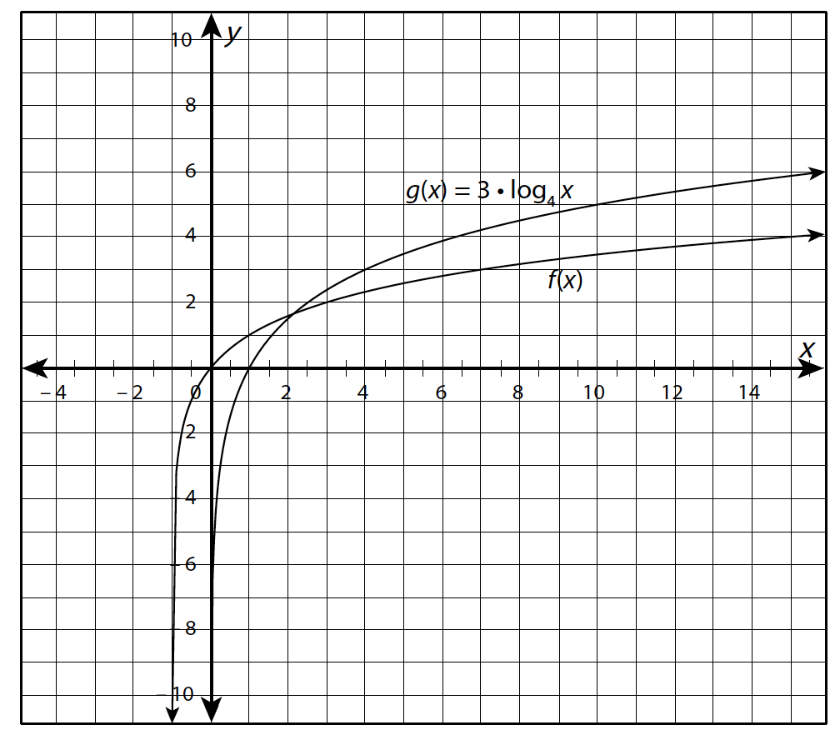
Guided Practice

Slide 59
Guided Practice: Example 3, continued
Determine the x-intercepts and their coordinates for each function.
Inspect the graph to determine this information.
The x-intercept of f(x) is 0, so the point is (0, 0).
The x-intercept of g(x) is 1, so the point is (1, 0).

Slide 60
Guided Practice: Example 3, continued
Substitute the coordinates of the x-intercept of f(x) into the form f(x) = a • log₄ (x + b).
This is the first step in writing f(x).
For x = 0, f(x) = 0. Substitute and solve.
f(x) = a • log₄ (x + b)
f(0) = a • log₄ [(0) + b]
= 0

Slide 61
Guided Practice: Example 3, continued
Divide the logarithmic term by a.
log₄ b = 0
b = 1 since 4⁰ = 1.
Substitute b = 1 in f(x) = a • log₄ (x + b).
f(x) = a • log₄ (x + 1)

Slide 62
Guided Practice: Example 3, continued
Use the other given points on the graph of f(x) to find a.
Substitute the given point (15, 14) into the f(x) function and solve.
f(x) = a • log₄ (x + 1) Function for f(x) found in the
previous step
(4) = a • log₄ [(15) + 1] Substitute 15 for x and 4 for f(x).
4 = a • log₄ (16) Add.

Slide 63
Guided Practice: Example 3, continued
4 = a • 2 Simplify.
2 = a Divide both sides by 2.

Slide 64
Guided Practice: Example 3, continued
Substitute the value of a into the equation for f(x) found in step 2.
This is the last step in writing f(x).
f(x) = 2 • log₄ (x + 1)

Slide 65
Guided Practice: Example 3, continued
Set f(x) = g(x).
This is the first step in finding the common solution of the two functions.
If f(x) = 2 • log₄ (x + 1) and g(x) = 3 • log₄ x, then 2 • log₄ (x + 1) = 3 • log₄ x for the value of x at which a common solution exists.

Slide 66
Guided Practice: Example 3, continued
Simplify the resulting equation.
Use the rules of logarithms.
2 • log₄ (x + 1) = 3 • log₄ x can be rewritten as log₄ (x + 1)² = log₄ x³.

Slide 67
Guided Practice: Example 3, continued
Rewrite the equation without logarithms.
When logarithms of the same base are equal, the arguments of those logarithms are equal.
Each logarithm has a base of 4; therefore, set the arguments equal to each other.
(x + 1)² = x³

Slide 68
Guided Practice: Example 3, continued
Explain how to find x in the resulting equation.
Since this is a cubic equation, expand the binomial and collect all terms on one side of the equation.
(x + 1)² = x³
x² + 2x + 1 = x³
x³ – x² – 2x – 1 = 0

Slide 69
Guided Practice: Example 3, continued
There are no small integer solutions to this cubic equation, so x can be found by determining the root of this cubic equation on a graphing calculator.
Alternatively, the point of intersection can be found by calculating it with the “calculate intersect” feature on a graphing calculator.
✔

Slide 70
Guided Practice
Example 4
The graph shows a logarithmic function of the form f(x) = a • log_{b} (x + c), where (–1, 2) is a point on the graph.
The exact x-intercept can be determined directly from the graph. Write the x-intercept and estimate the value of the y-intercept from the graph.
Then, calculate the actual y-intercept and compare this value with the estimate.

Slide 71
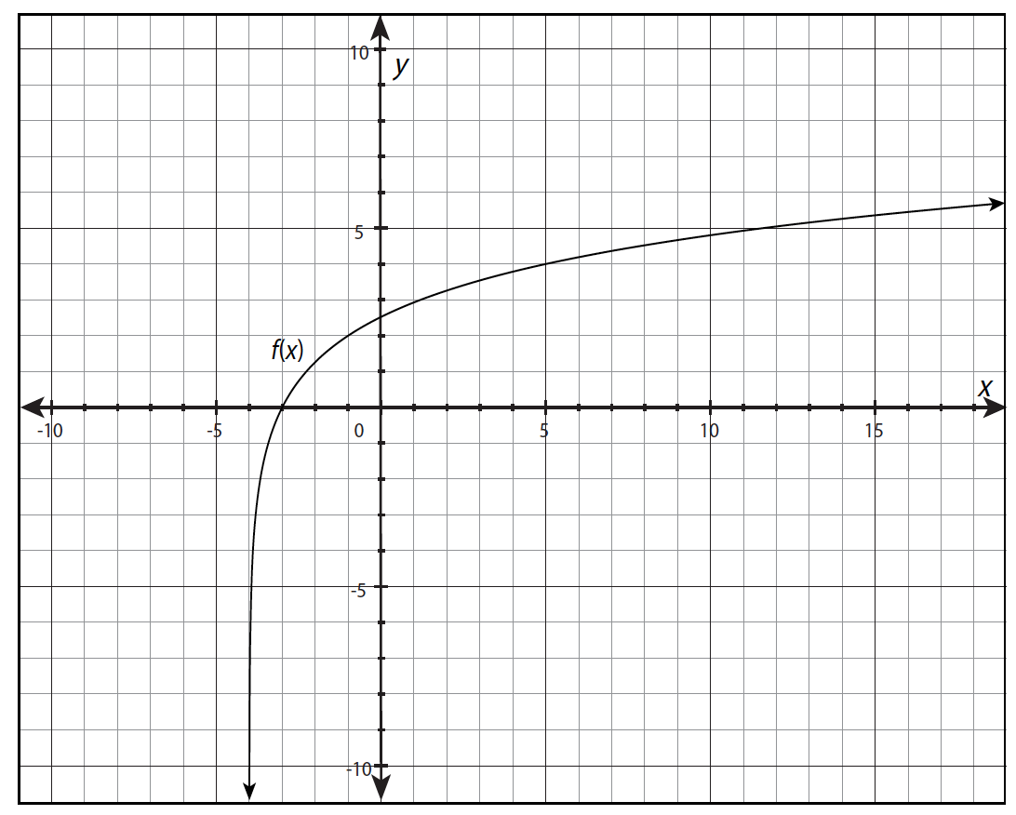
Guided Practice

Slide 72
Guided Practice: Example 4, continued
Identify the x-intercept from the graph and write its coordinates.
The x-intercept can be used to help identify the constants in the general form of the function and find the y-intercept.
The x-intercept is located at the point where the graph crosses the x-axis, or where y = 0.
The x-intercept is –3, so the point containing it is (–3, 0).

Slide 73
Guided Practice: Example 4, continued
Estimate the y-intercept from the graph.
The x-intercept can be used to help identify the constants in the general form of the function and find the y-intercept.
The x-intercept is located at the point where the graph crosses the x-axis, or where y = 0.
The x-intercept is –3, so the point containing it is (–3, 0).

Slide 74
Guided Practice: Example 4, continued
Determine the equation for the y-intercept.
The y-intercept can be calculated by evaluating the function at x = 0.
To do this, first determine the equation for the y-intercept.
The function is in the form f(x) = a • log_{b} (x + c), so substitute 0 for x and simplify.

Slide 75
Guided Practice: Example 4, continued
f(0) = a • log_{b} (0 + c)
= a • log_{b} c
The equation for the y-intercept can be written as f(0) = a • log_{b} c.

Slide 76
Guided Practice: Example 4, continued
Use the x-intercept and the given point (–1, 2) to find the constants in the function.
To find one or more of the constants, substitute the coordinates of the x-intercept found in step 1 into the form f(x) = a • log_{b} (x + c).
The x-intercept is located at (–3, 0).

Slide 77
Guided Practice: Example 4, continued
f(x) = a • log_{b} (x + c) Given function form
(0) = a • log_{b} [(–3) + c] Substitute –3 for x and 0 for f(x).
0 = log_{b} (c – 3) Divide both sides by a and simplify.
b⁰ = c – 3 Apply the power rule of logarithms.
1 = c – 3 A quantity raised to a 0 power is equal to 1.
4 = c Add 3 to both sides.

Slide 78
Guided Practice: Example 4, continued
Therefore, if c = 4, then f(x) = a • log_{b} (x + 4).
Now substitute (–1, 2) into f(x) = a • log_{b} (x + 4) to find a.
f(x) = a • log_{b} (x + 4) Function from the previous step
2 = a • log_{b} [(–1) + 4] Substitute –1 for x and 2 for f(x).
2 = a • logb 3 Add.
Divide both sides by log_{b} 3.
The known constants are and c = 4.

Slide 79
Guided Practice: Example 4, continued
Substitute the value of a into the equation for the y-intercept.
Use the equation for the y-intercept determined in step 3.
f(0) = a • log_{b} c Equation for the y-intercept
Substitute for a and 4 for c.
Rewrite the multiplication.
f(0) = (log₃ 4)² Simplify.

Slide 80
Guided Practice: Example 4, continued
Use a calculator to evaluate (log₃ 4)².
Rewrite (log₃ 4)² as using the power and quotient rules.
The y-intercept is approximately 2.52.

Slide 81
Guided Practice: Example 4, continued
Compared the estimated y-intercept from the graph with the calculated y-intercept.
Though the graph suggests that the y-intercept appears to be at (0, 2.5), the y-intercept is actually closer to approximately (0, 2.52), a difference of approximately 0.02.
✔

